Slide 1

IHR Hackaton Report
WIDE meeting, June 2020

Slide 2
1 theme
7+ participants
How can we measure networks healthiness?
- Romain Fontugne (IIJ)
- Kenjiro Cho (IIJ)
- Anant Shah (Verizon (Edgecast))
- Satoru Kobayashi (NII)
- Porapat Ongkanchana (UTokyo)
- Hidetaka Masuda (UTokyo)
- Akira Kato (Keio)

Slide 3
Knowledge sharing
Spent two hours discussing network measurement topics:
DNS analysis / performance
Traceroute analysis
Internet latency
Routing / AS dependency
Healthiness of IPv4 vs. IPv6
IP geolocation
Visualization

Slide 4
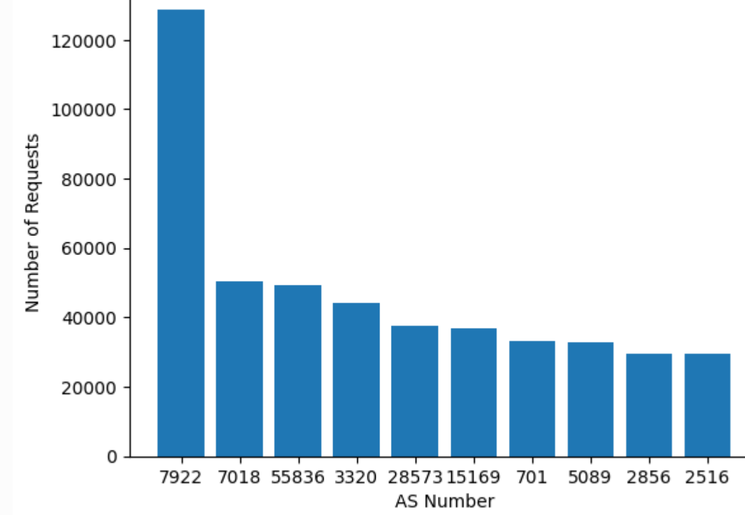
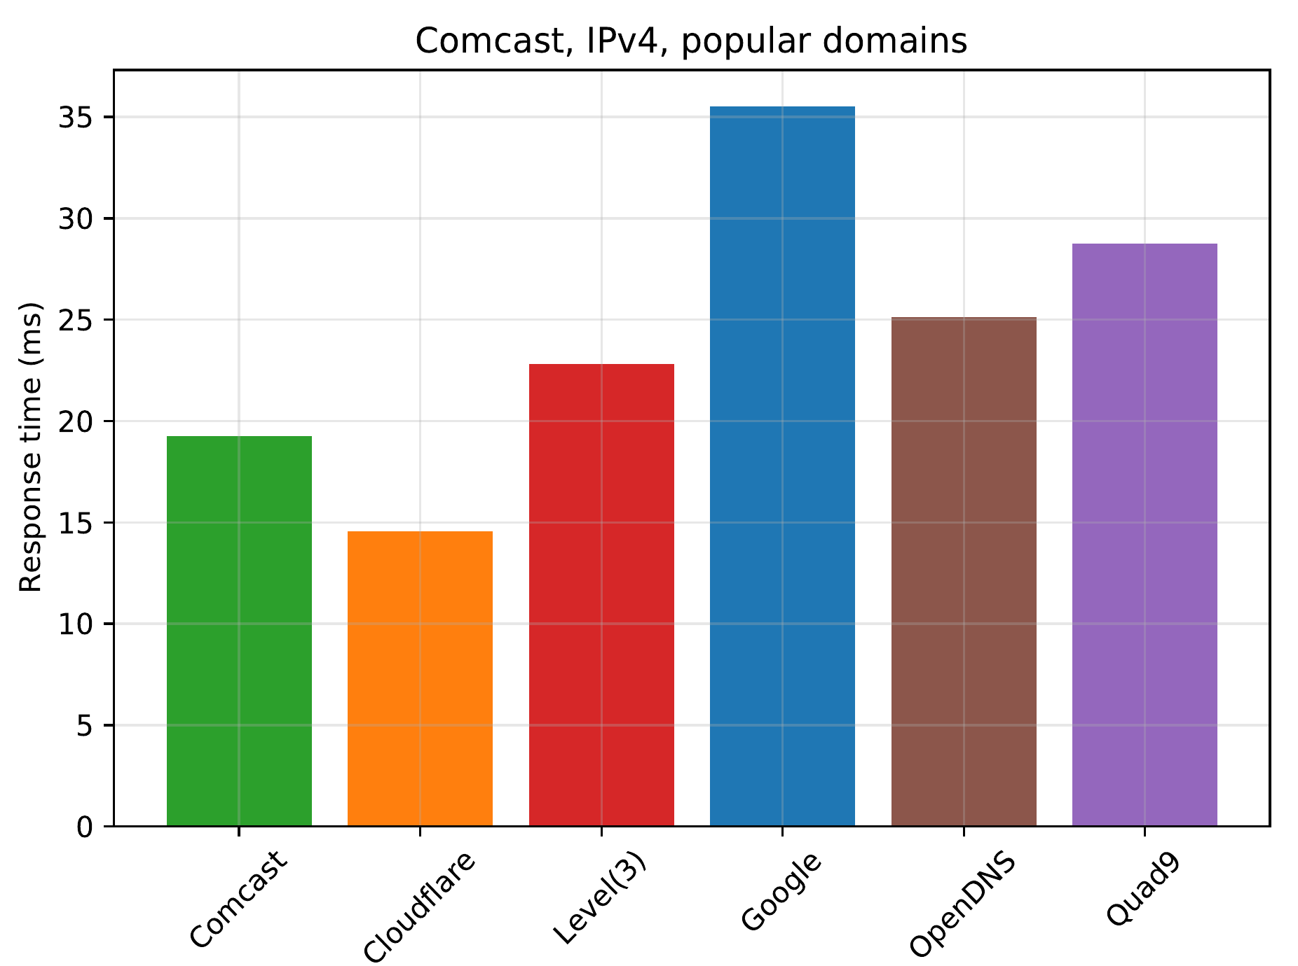
Three projects
MLab throughput measurements
(usability of this open dataset?)
Learned about Google BigQuery
Compute throughput & nb. Tests
https://hackmd.io/p-pWJ2KPS82kWu6ueTIJOA
DNS performance
(comparison public resolver)
https://github.com/romain-fontugne/ihr_hack_dns/
City-level dependency
(e.g. Japanese ISPs depends a lot on Otemachi)
Survey state of the art
‘Research plan’: https://kiuchi.hongo.wide.ad.jp/p/ihr

Slide 5
Takeaways
A lot of ideas, too little time!
We still know little about the Internet at scale
Hackathon are good for trying new things
We are good at data analysis but bad at visualization
Virtual hackathon are doable, though we missed pizza and beers
Maybe we shouldn’t run too many hackathon in parallel? Coordinate better with other hackathons?

